Slide 1
Building Data Infrastructures
Lessons Learned
Julia Lane
New York University
American Institutes for Research
University of Strasbourg
University of Melbourne

Slide 2
Key ideas
Big ideas; small steps
Work hard; have fun
Create value; spread credit

Slide 3
Overview
Some background
Illustrative example
Lessons Learned
  Identify gaps
  Create a team
  Build coalitions
  Develop products
Key role of private foundations

Slide 4
Overview
Some background
Illustrative example
Lessons Learned
  Identify gaps
  Create a team
  Build coalitions
  Develop products
Key role of private foundations

Slide 5
Some Background
Policy (LEHD)
Return to training
Impact of firms on workers (low wage work)
Impact of workers on firms (productivity and competitiveness)
Need linked employer-employee data
Begin pilot project with MD UI wage records at Census
Policy (Enclave)
Impact of advanced technology grants on competitiveness
Role of small businesses in entrepreneurship and innovations
Impact of farm policy on farm outcomes
Need researcher access to confidential microdata
Begin pilot project to build remote access data enclave at NORC/UofChicago
Eventually, 5 federal, 150 state agencies combined for LEHD program
Eventually platform for multiple federal and state agencies, private foundations; access for over 400 researchers
Policy (IRIS)
Returns to investment in R&D
Link between R&D and innovation
Understanding STEM workforce demand and supply
Need “big data” approach to link funding, research networks and outputs/outcomes
Begin STAR METRICS program with White House/NSF/NIH; added EPA, USDA and DOE; 100 universities
Begin extended UMETRICS program with CIC institutions
Establish Institute for Research on Innovation and Science

Slide 6
Overview
Some background
Illustrative example
Lessons Learned
  Identify gaps
  Create a team
  Build coalitions
  Develop products
Key role of private foundations

Slide 7
Origins of STAR METRICS
Feedback from the 2008 SoSP Workshop: shaped interagency research priorities for SOSP:
  Developing a Data Infrastructure for Science and Innovation Policy
  Modeling
  Creating an Innovation Framework
  Informing and Assessing R&D Investments
  Conducting Outreach to Underrepresented Populations
  Memo re data infrastructure drafted for incoming Obama administration January 2009
Feedback from 2009 SoSP Workshop: Best Practices in Research and Development Prioritization, Management, and Evaluation
  Building community of practice
  Focus on link to research coming out of NSF SciSIP program

Slide 8


Origins
Investment in Science
  American Recovery and Reinvestment Act
  The National Academy of Sciences Speech, April 2009
Openness and transparency
  data.gov; open.gov; etc.
Evidence based policy
  Joint memo on “Science and Technology Priorities for the FY2011 Budget” : Science of Science Policy (is the only program listed by name)
Accountability
  ARRA Reporting Guidelines
  Putting Performance First: Replacing PART with a new performance improvement and analysis framework
8

Slide 9
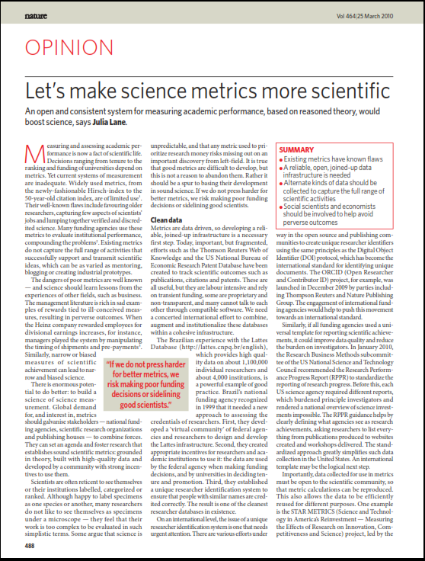
Goal: Get it Right

Slide 10

Goal: Get it right
Empirical Framework
  Timely
  Generalizable and replicable
  Low cost, high quality
  Big Data (in this context)
  - Disambiguated data on individuals
  Automatic data creation
  New text mining approaches….

Slide 11
Approach
Level 1: Document the levels and trends in the scientific workforce supported by federal funding.
Level 2: Develop an open automated data infrastructure and tools that will enable the documentation and analysis of a subset of the inputs, outputs, and outcomes resulting from federal investments in science.

Slide 12
Approach: STAR Pilot
ARRA called for calculation of impact of science on jobs; we responded to AAU concern
Partnered with FDP Institutions
  Asked for administrative records
  Asked for assistance in development of metrics
Automatically generated job creation measures
  Created administrative tracking system
    Existing payroll management systems (similar to unemployment insurance wage records)
  External validation and accountability
Notes:
Existing experience with job creation in LEHD program at Census Bureau – 10 years of developing job creation algorithms and useful products from existing data

Slide 13
STAR
Pilot
Project
Institution
STAR
Agency Budget
Award
Record
Acquisition
And Analysis
Agency
Award
Direct
Benefit
Analysis
State
Funding
Institution
Endowment
Funding
Papers
Intellectual
Property
Benefit
Analysis
Financial System
Research
Project
Disbursement
Patents
Start-Up
Innovation
Analysis
HR System
Procurement
System
Subcontracting
System
Personnel
Vendor
Contractor
Jobs,
Purchases,
Contracts
Benefit
Analysis
Hire
Buy
Engage
Existing
Institutional
Reporting
Detailed
Characterization
and
Summary
State
Download
Notes:
Flowchart based on university reporting systems, but portable to other HR/Finance systems. Presented to and validated by pilot FDP universities

Slide 14
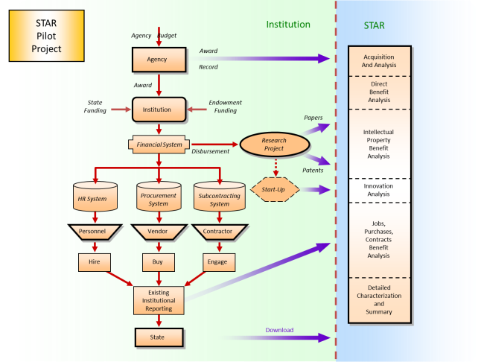
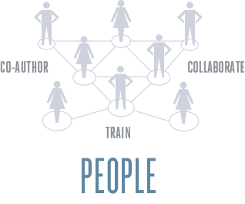

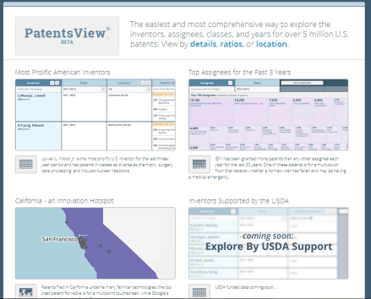

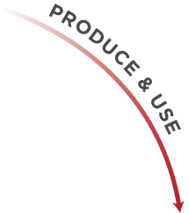



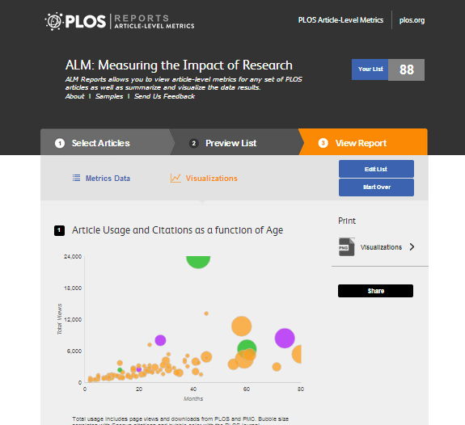

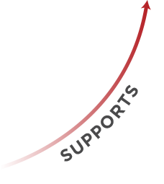
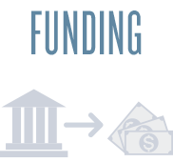
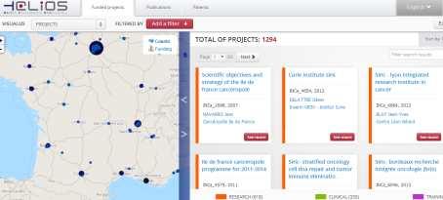
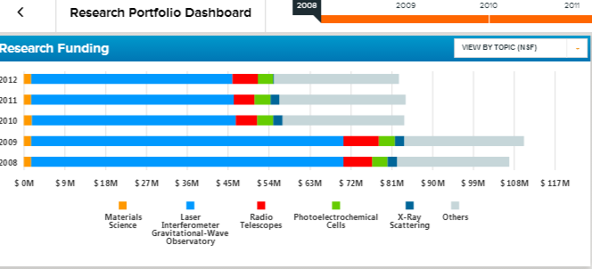
The Empirical Framework
Source: Ian Foster, University of Chicago

Slide 16
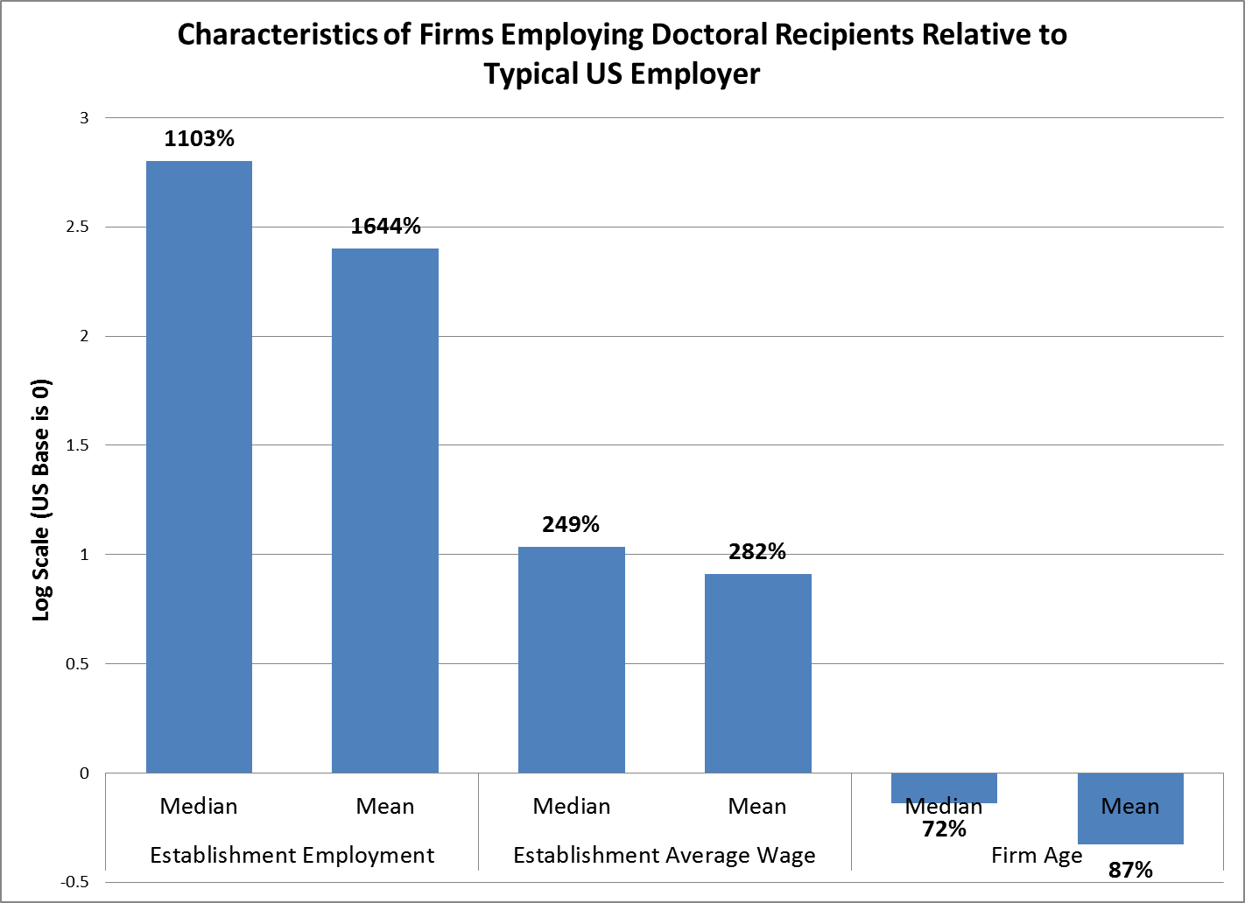

Slide 17
Results
Independent statistical evidence about national, regional & local economic impact
$1.949 Billion in Direct Cost Vendor Purchases from 9 CIC Universities, Q3 2012-Q4 2014
Notes:
Vendors and subs in 1770 US counties, ~497M dollars spent in home states.

Slide 18
Startup Business Dynamics (Matched through SS-4)

Slide 19
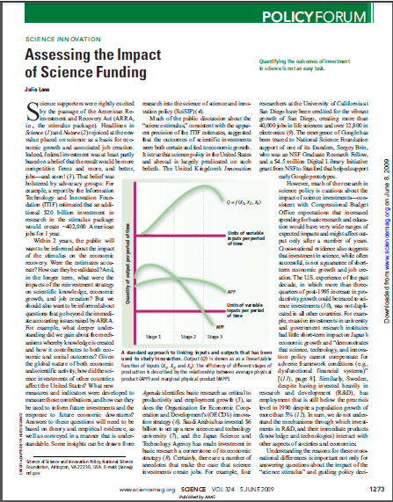
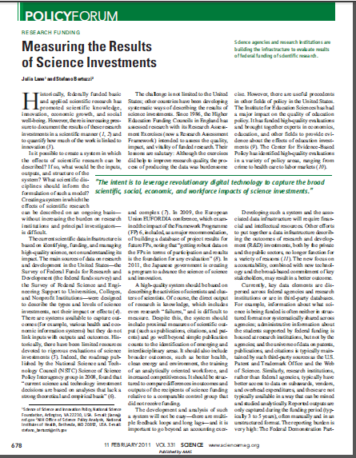
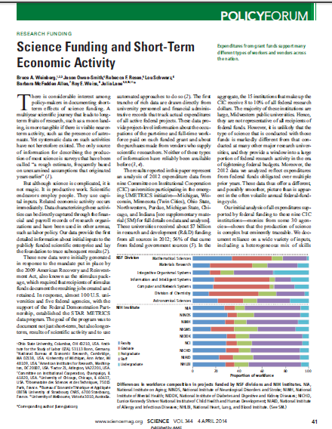
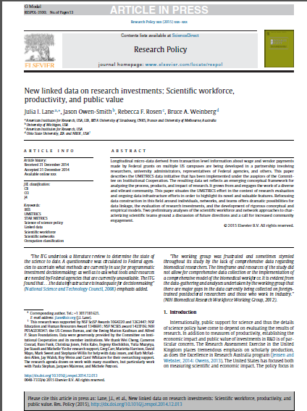
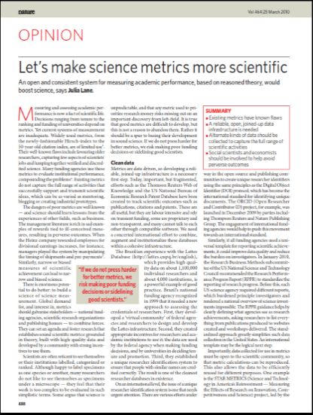
Research outputs from this approach

Slide 20
Overview
Some background
Illustrative example
Lessons Learned
  Identify gaps
  Create a team
  Build coalitions
  Develop products
Key role of private foundations

Slide 21
Identify gaps
LEHD
  UI wage record research (1990-94)
  Returns to training (World Bank research, 1993-96)
  Census Bureau meeting (1996)
  Conference (1998)
NORC Enclave
  LEHD access (2000-2004)
  Confidentiality book (2001)
  JSM panel (2005)
  NIST (2005)
IRIS
  NSF program (2008)
  Azoulay (2008)
  ARRA (2009)

Slide 22
Create a team
LEHD
  Champions
  Brothers in arms
  Visionary researchers
  Operational producers
  Funders (Sloan, NIA, NSF, HHS/ASPE)
  Approach: Annual workshops; newsletters; presentations
NORC Enclave
  Champions
  Brothers in arms
  Visionary researchers
  Operational producers
  Funders (NIST, Kauffman, USDA/ERS)
  Approach: Newsletters; presentations

Slide 23
Create a team
IRIS
  Champions (FDP, CIC, AAU, Census)
  Brothers in arms (Rebecca Rosen, Bruce Weinberg, Jason Owen SMith)
  Visionary researchers (Chris Jones, Evgeny Klochikhin, Kaye Husbands Fealing, John King, Nik Zolas, Nathan Goldschlag…..)
  Operational producers (Lou Schwarz, Census)
  Funders (Sloan, Kauffman, NSF/EHR)
  Approach: Regular workshops; newsletters; presentations

Slide 24
Build coalitions
LEHD
  Federal (Census, NIA, HHS, SSA, IRS)..
  State (MD, IL, FL, CA, CO)..
NORC
  Data producers (NIST, Kauffman, USDA)
  Data users (research community, IASSIST)
IRIS
  Science Agencies (OSTP, NSF, NIST, USDA, EPA)..
  Universities (CIC, Penn, SUNY..)..
  Research community (high profile researchers)

Slide 25
Create Products
LEHD
  Quarterly Workforce Indicators
  On the Map
  Research results
NORC
  Enclave itself
  Research
IRIS
  Two page reports
  Dashboards
  Hot reports
  Research
  In all cases, much trial and error; beta tests; engagement critical throughout

Slide 26
Overview
Some background
Illustrative example
Lessons Learned
  Identify gaps
  Create a team
  Build coalitions
  Develop products
Key role of private foundations

Slide 27
Role of private foundations
Mission oriented
Longer horizon/repeated game
Investments in people (Azoulay)
Seed funding

Slide 28
Key ideas
Big ideas; small steps
Work hard; have fun
Create value; spread credit

Slide 29
Thank you!
Julia.lane@nyu.edu

