Slide 1
Privacy and confidentiality

Slide 2
Overview
Data facility mission
Background
Approach
Safe People
Safe Projects
Safe Settings
Safe Outputs
=> Safe Data
What does this mean for you?

Slide 3
Overview
Data facility mission
Background
Approach
Safe People
Safe Projects
Safe Settings
Safe Outputs
=> Safe Data
What does this mean for you?

Slide 4
Mission
To achieve two goals:
(i) Make new and existing urban data available to and used by current and future members of the research community in a state of the art facility, while protecting confidentiality and
(ii) Engage staff in government agencies and local citizens to use the facility to addressing important urban problems.

Slide 5
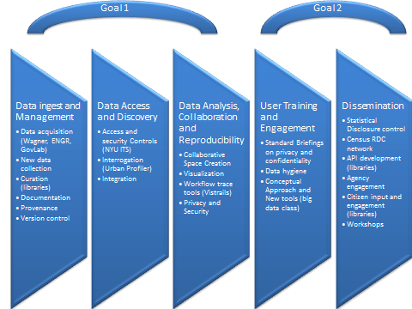

Slide 6
Overview
Data facility mission
Background
Approach
Safe People
Safe Projects
Safe Settings
Safe Outputs
=> Safe Data
What does this mean for you?

Slide 7
Access to microdata critical
1. Analyze more realistic questions
2. Develop reality-based policy
3. Acquire new constituencies and stakeholders
4. Build trust; reduce suspicions of data cooking
5. Replicate findings
a. use standards of UNSD, Eurostat, ISCO, ISCED, etc.
b. facilitate comparative research in time and space
6. Calculate marginal effects
Assess data quality
(Keynote I gave to Council of European Statisticians in 2003)

Slide 8
Protecting Confidentiality critical
Ethical Reasons
Right thing to do
Legal Reasons
NYU loses federal funding
Practical Reasons
Lose access to data

Slide 9
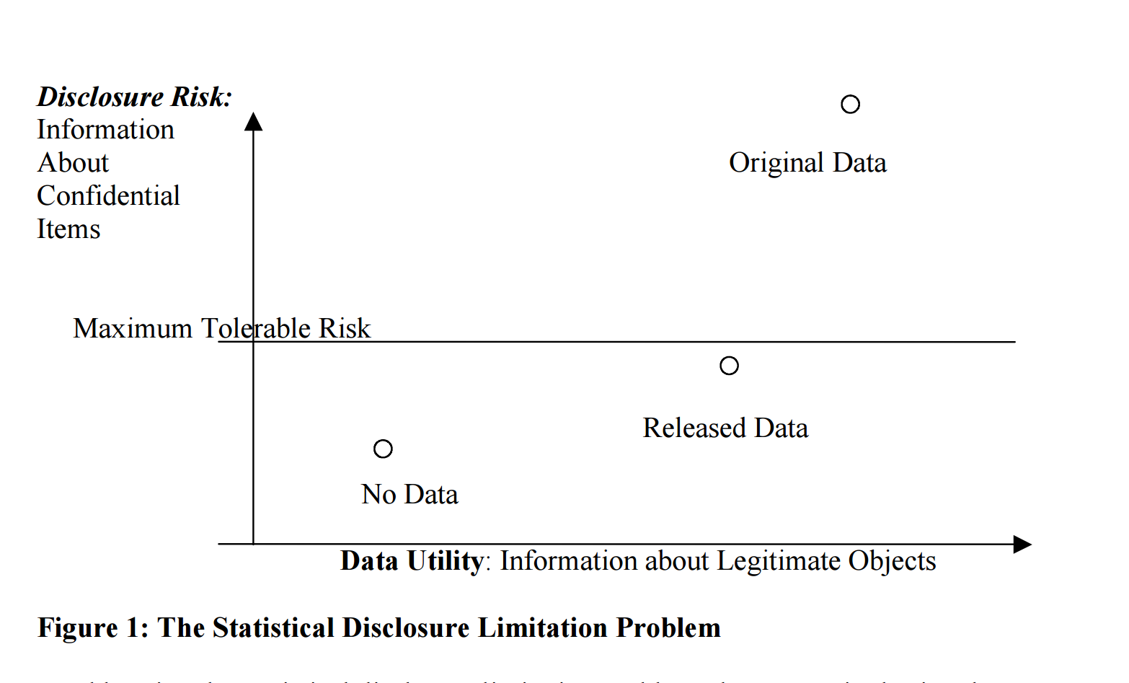
But risk/utility tradeoff
Source: George Duncan et al.

Slide 10
But

Slide 11
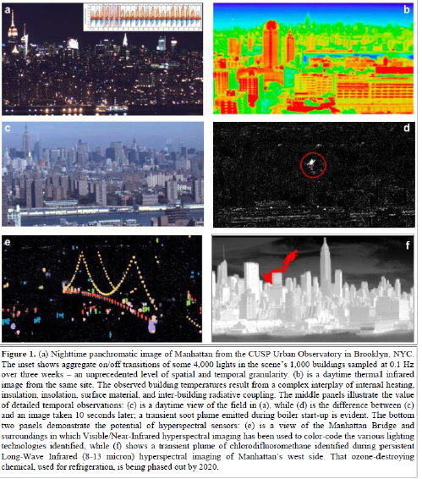
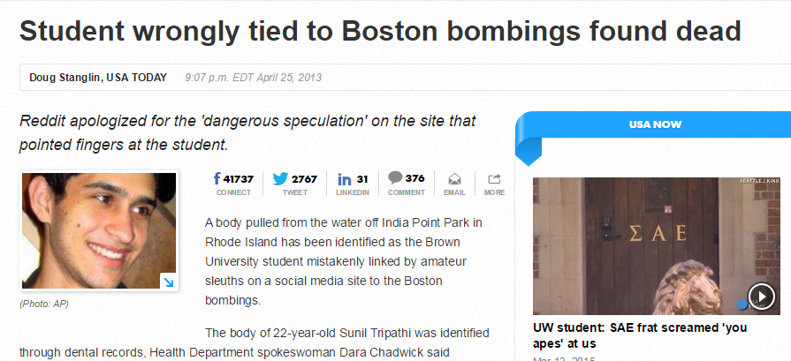
Lots of new challenges
States
Cities
Citizens
Buildings
Atmosphere

Slide 12
New types of research
New analytical model
Outliers
New units of analysis
New sets of skills
Computer scientists
Citizen scientists

Slide 13
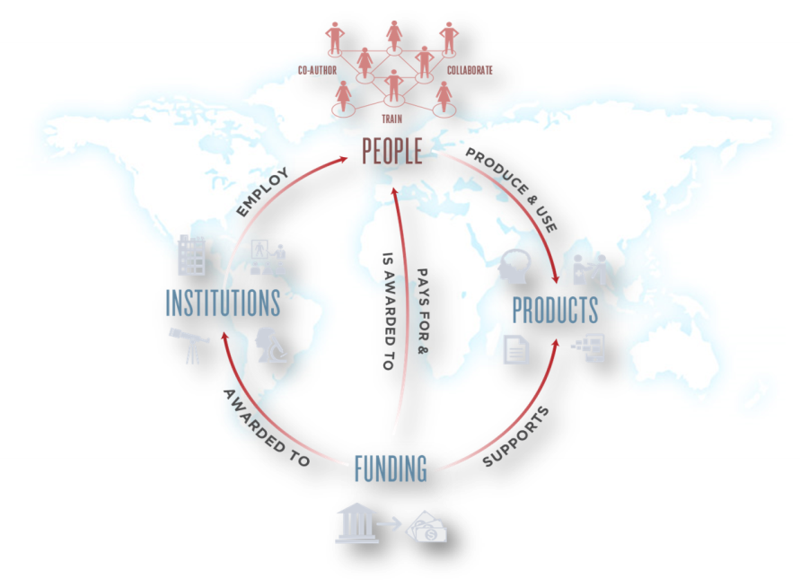
New analytical challenges
Frames created by linkage
Match error
Coverage error
New error framework
Replication essential
This is really hard work
=> Community effort essential and access is essential

Slide 14
NAS recommendations
Source: Julia Lane

Slide 15
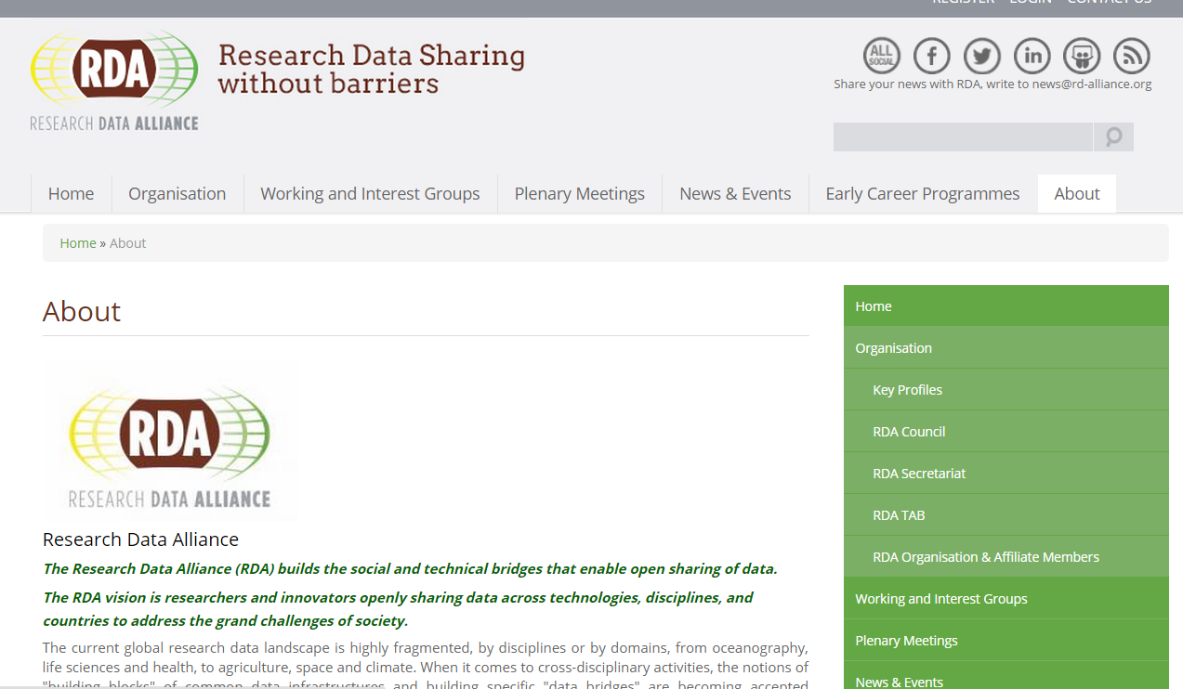
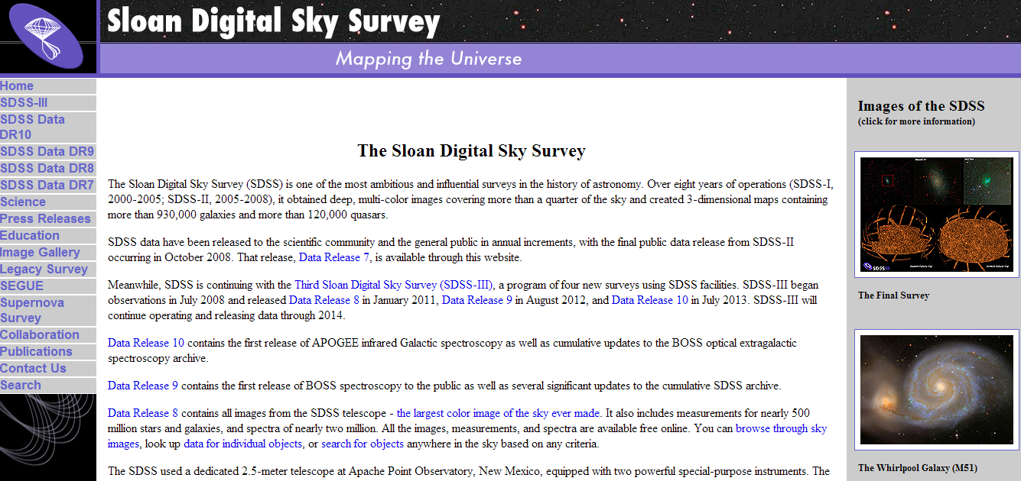
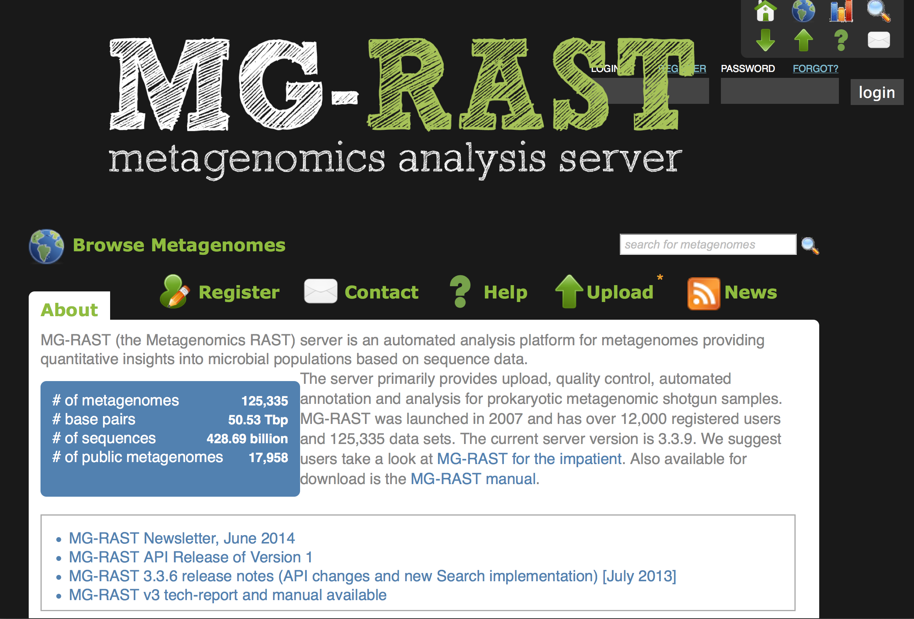
Build on other fields

Slide 16
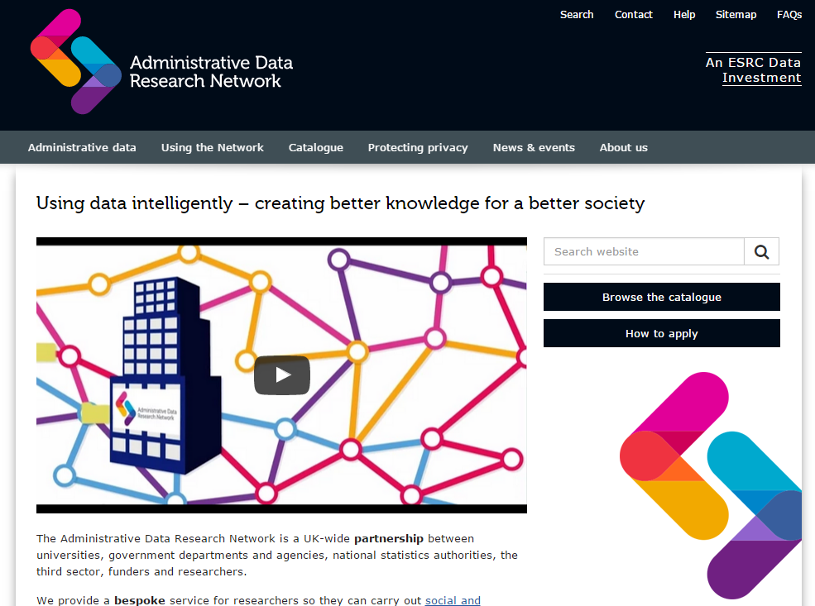
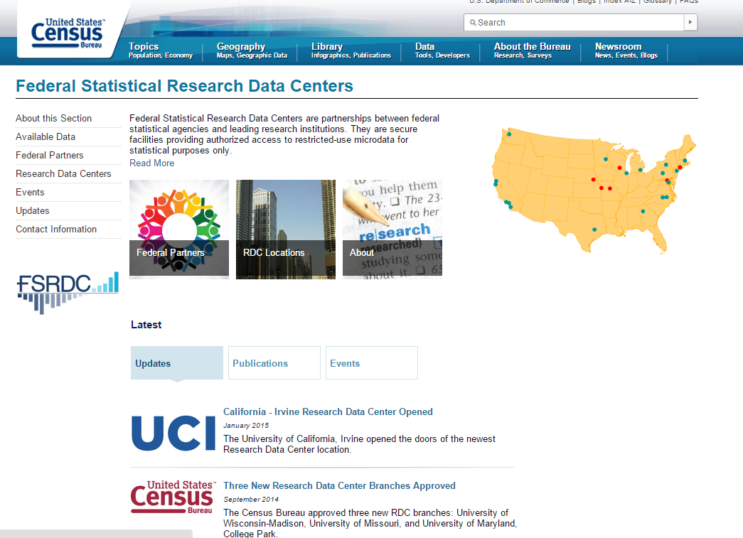
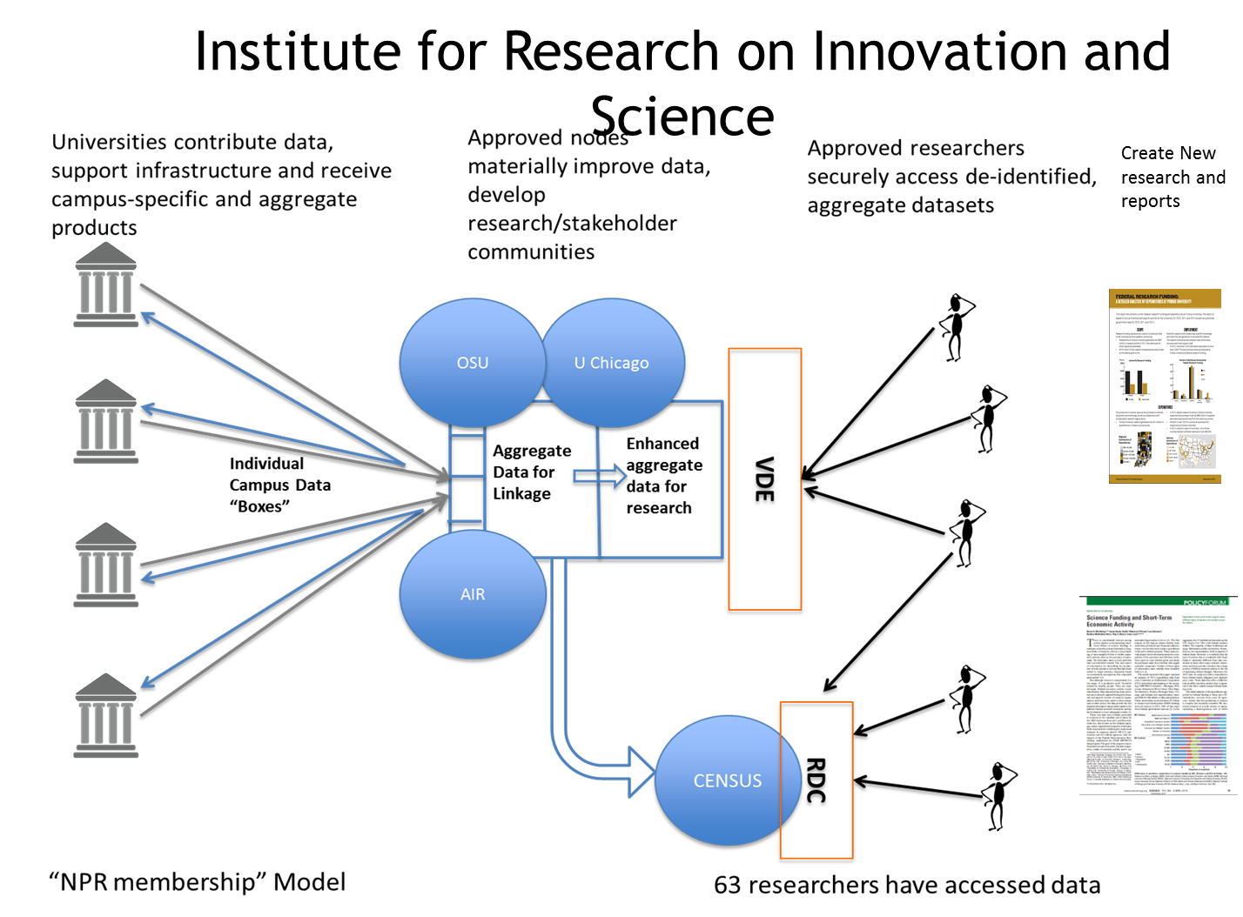
Build on existing infrastructures

Slide 17
Overview
Data facility mission
Background
Approach
Safe People
Safe Projects
Safe Settings
Safe Outputs
=>Safe Data
What does this mean for you?

Slide 18
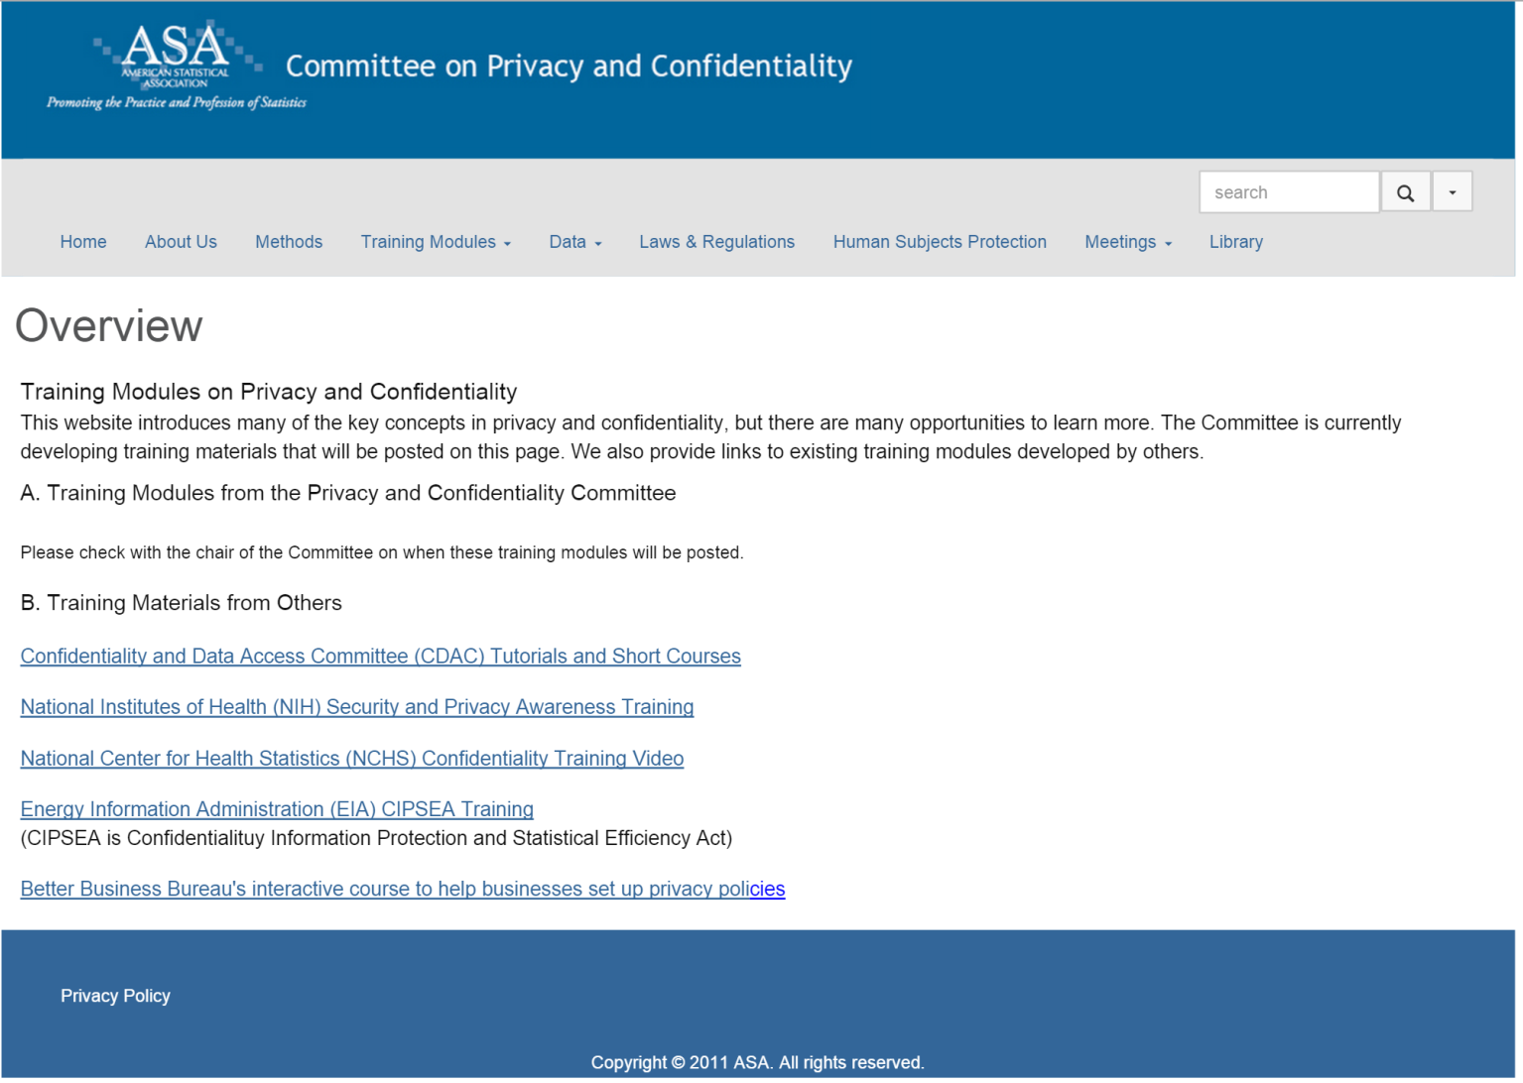
Safe people

Slide 19
Safe Projects

Slide 20
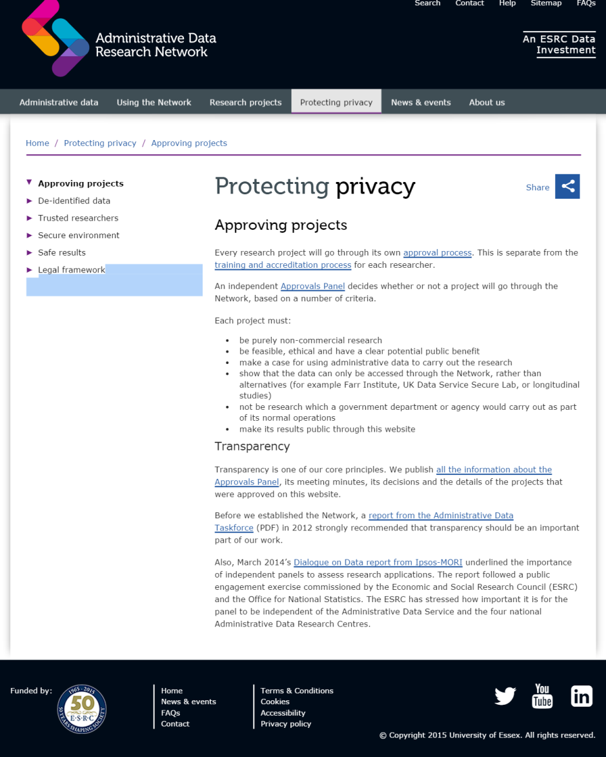

Slide 21
Safe Settings

Slide 22
Data Classification
Disclosable aggregate research datasets
Disclosable reporting DCs for APIs and webtools
City-owned data with no identifiers
NYC Open Data
Public data from other sources
UO images (blurred) with geotags
De-identified administrative microdata
De-identified education microdata
De-identified health records
Feature data (images, sound, etc.)
Genetic data
Human faces
Human conversations
Educational records with identifiers
Heath records with identifiers
Administrative microdata
PII data

Slide 23
Safe Setting
Get to know the CUSP Data Facility
CUSP Account
CUSP Infrastructure
4- Remote Desktop Access
1- CUSP HUB
(Info, FAQ)
2- CUSP Data Catalog
3- CLI Access
Computing servers
*below
5- CUSP Hue interface
( hadoop cluster)
6-CUSP
Open Data/ Restricted Data

Slide 24
CUSP Account request
Email cusp.it@nyu.edu
New User Provides:
Title or affiliation: ex: CUSP Student, Class of 2015/2016
CUSP Account Access:
Full name:
NetID:
Email Address: (NYU)
CUSP Infrastructure
CUSP Data Catalog
Provided by CUSP:
CUSP account
Temporary Password, prompted to change upon first access
CUSP Info Hub
Compute space> Open Data Mart> Student Data Mart
HUE web platform

Slide 25
CUSP Account Request process
1.
2.

Slide 26
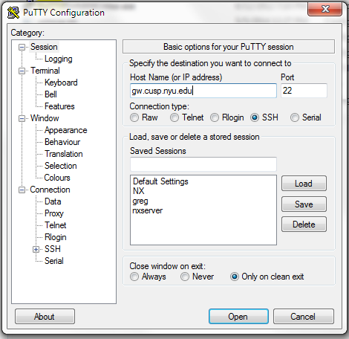
CLI option 1 - CUSP user on a CUSP Workstations in CUSP LAN (Local Area Network) can access cusp computing servers with CLI using SSH (secure shell) to CUSP gateway gw.cusp.nyu.edu)
If you have a Mac, open a terminal window
OR
If you have Windows as an OS, download a free SSH client like PuTTY
TYPE: shell.cusp.nyu.edu

Slide 27
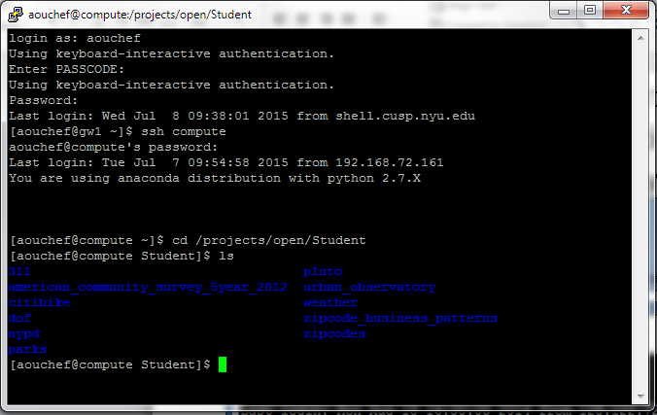
CUSP Student open data access SSH to CUSP computing system (compute.cusp.nyu.edu)
Log In using CUSP ID and Password
Type: ssh compute
Path: /projects/open/Student
You will find approximately 10 datasets to “play with”

Slide 28
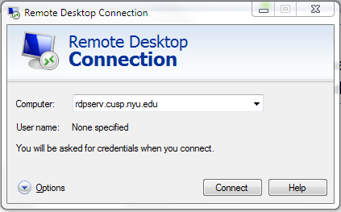
CUSP Student Access from Internet use a remote desktop client to access CUSP xrdp server (rdpserv.cusp.nyu.edu
RDP access from internet is granted to a specific group,
A request needs to be submitted to cusp.it@nyu.edu for evaluation

Slide 29
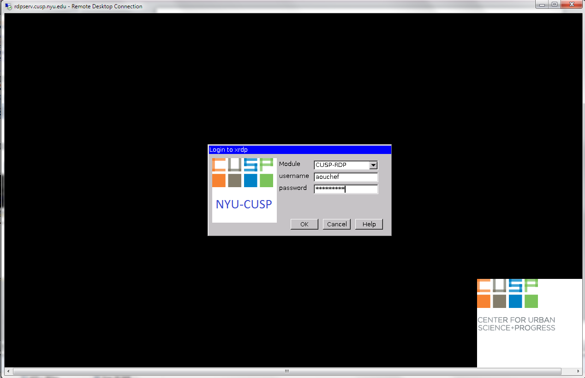
CLI Option 2 - A CUSP user with CUSP ID/CUSP password and belong to the RDP group can access restricted remote desktop environment at CUSP from internet.

Slide 30
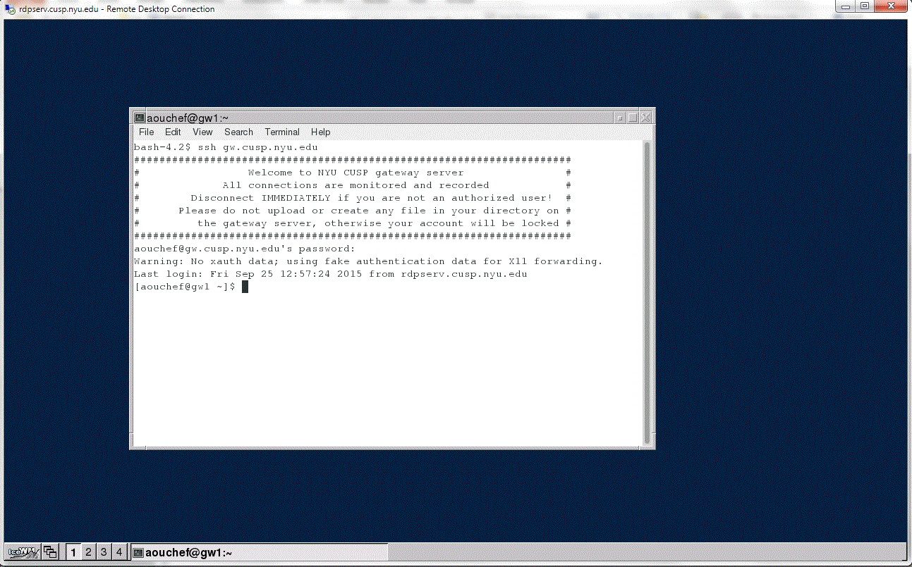
Student will use a terminal window (gnome-terminal) to access gw.cusp.nyu.edu using
CUSP ID and CUSP password . From the gateway server Researcher/Student can access CUSP CDF computing servers ( “compute “ or “hadoop cluster” as well as the OPEN DATA

Slide 31
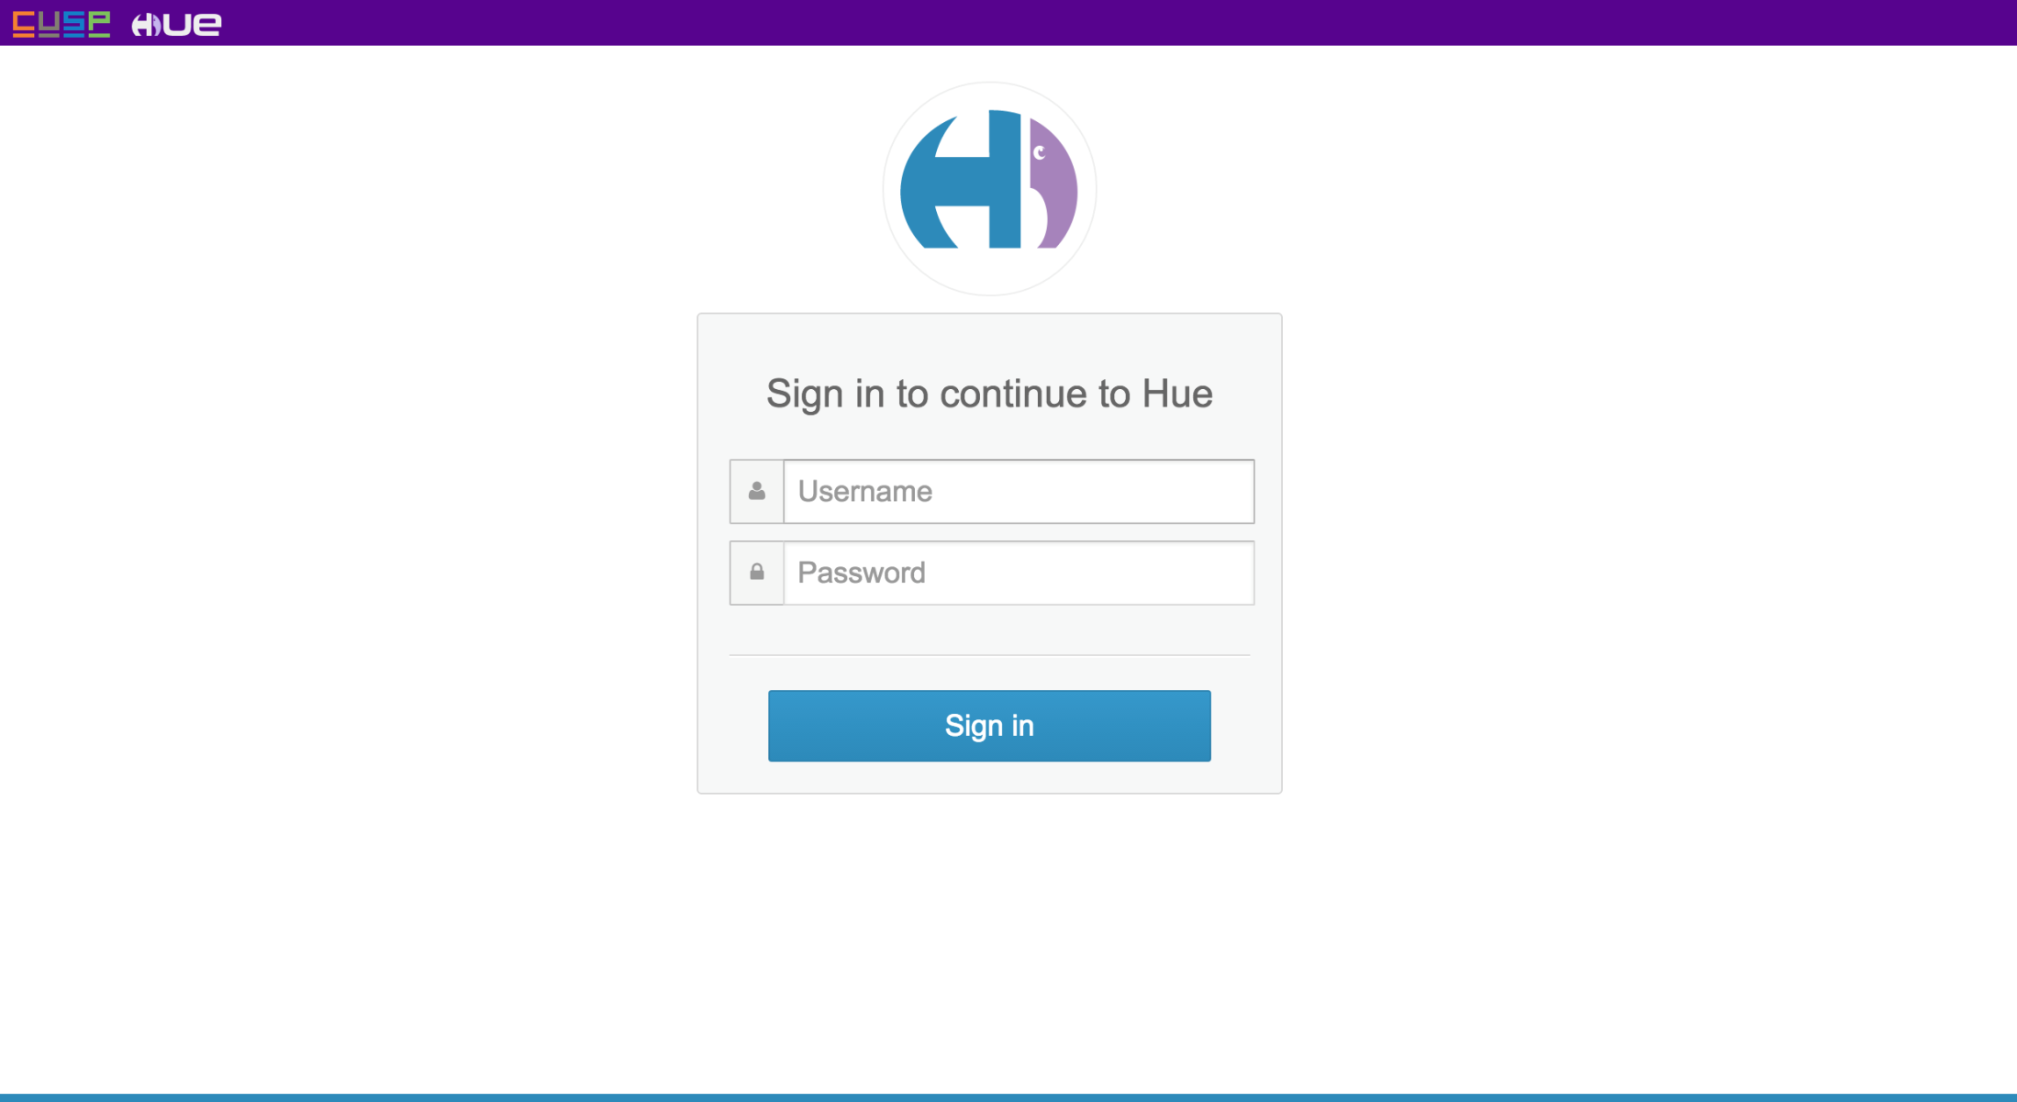
Option 3 - A CUSP user with CUSP ID/CUSP password can access and analyze green data environment at CUSP from internet.

Slide 32
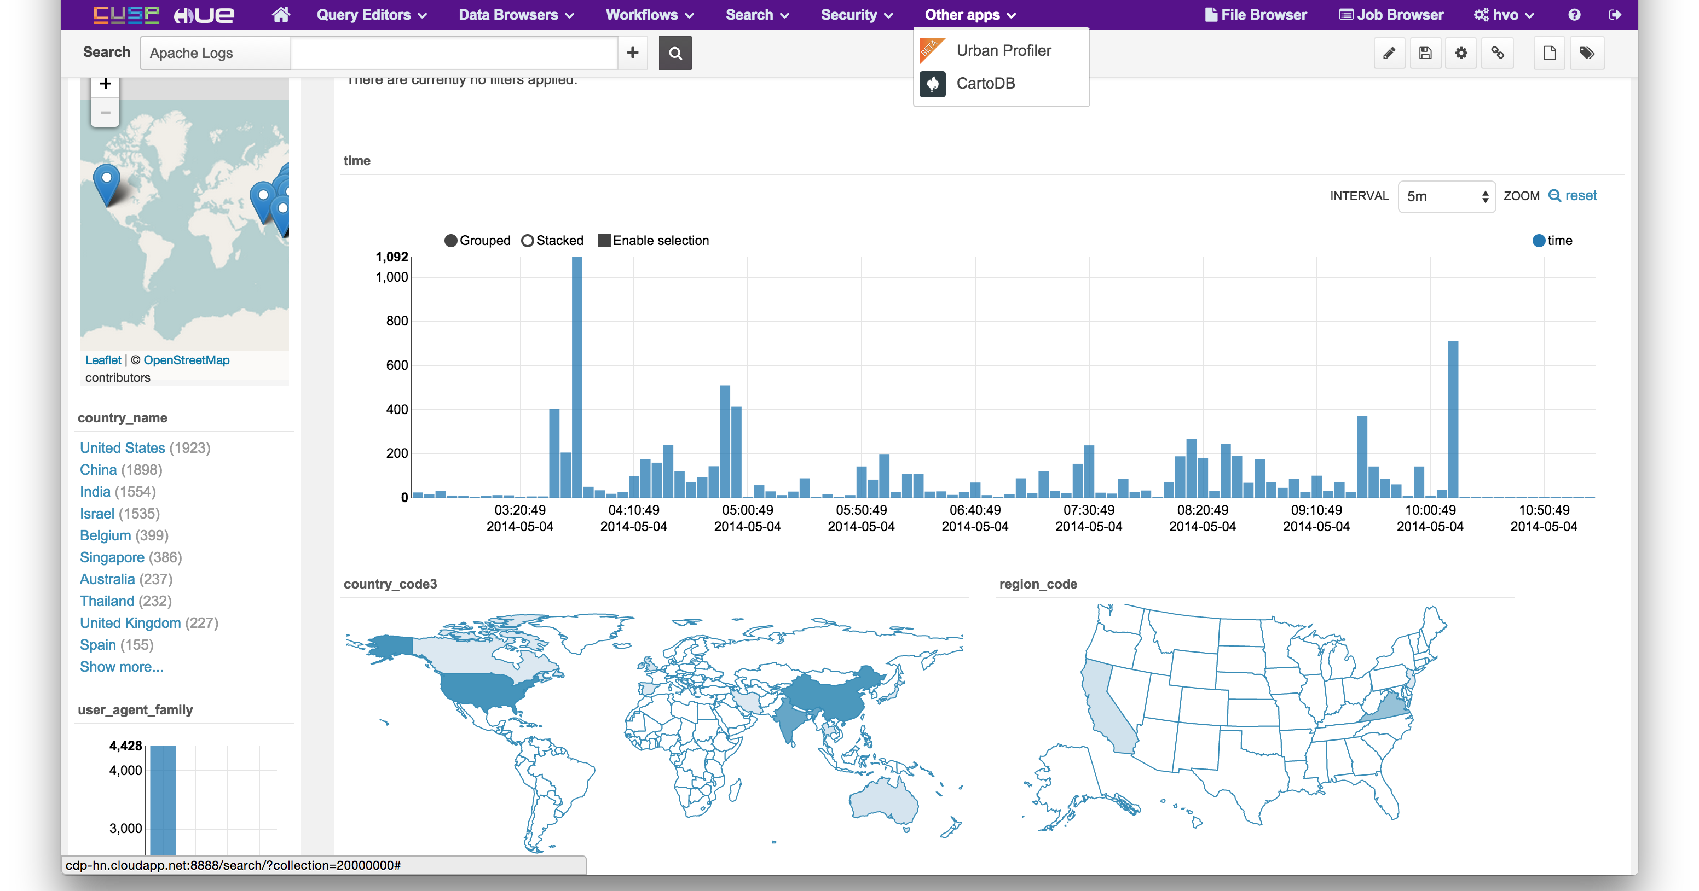
HUE as a CUSP Data Platform for Analysis of Green Data

Slide 33
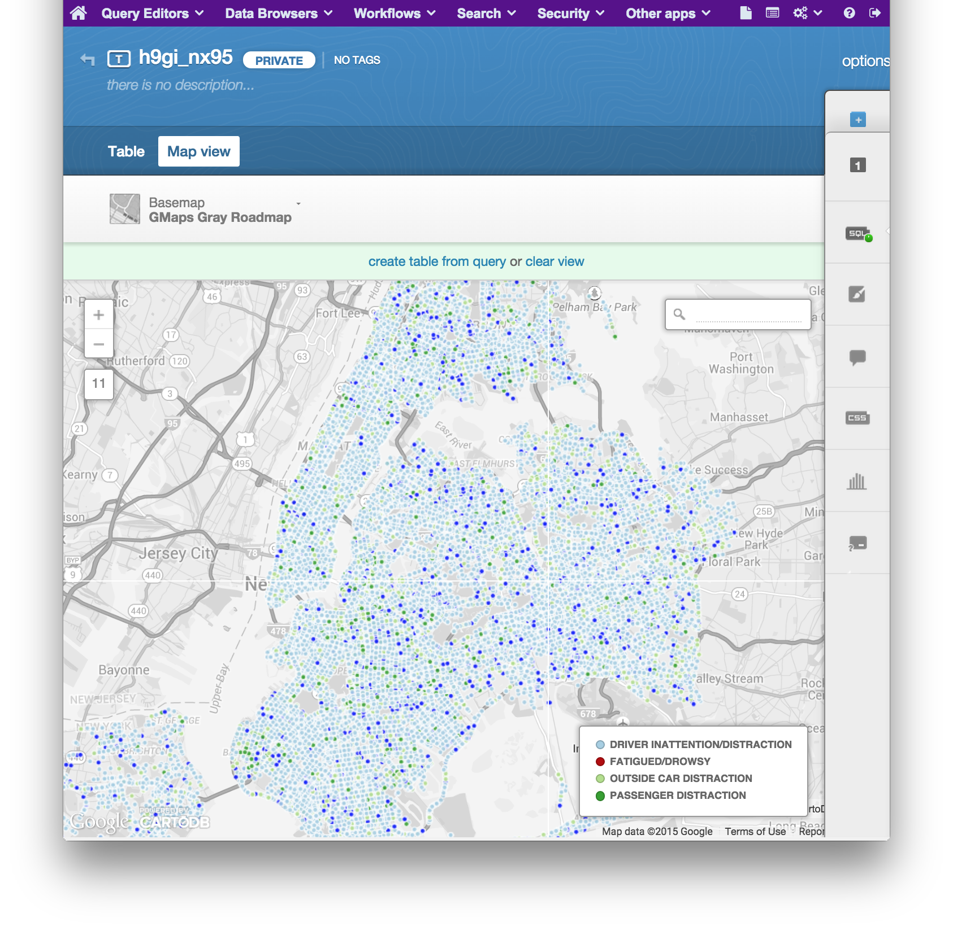
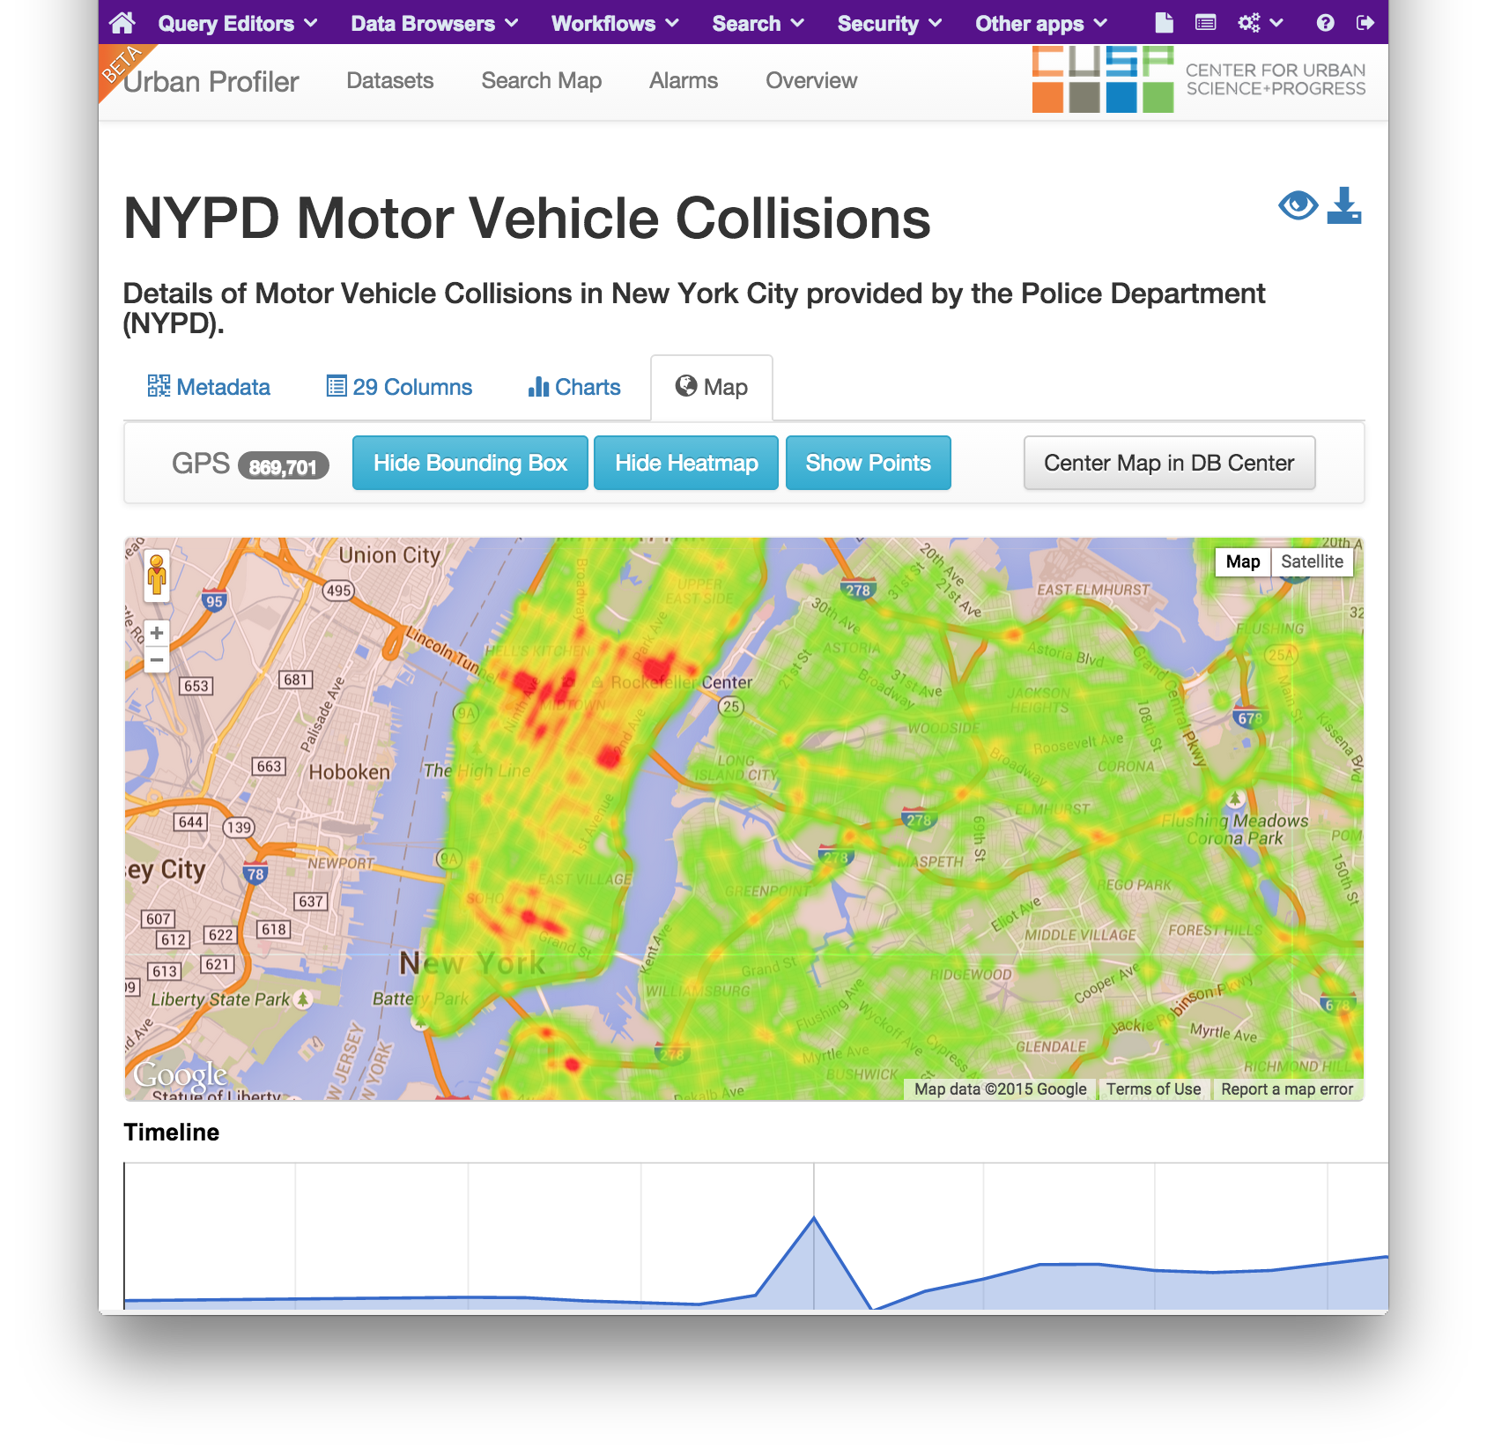
Add-on Applications to HUE
App: CartoDB
(open-source integration)
App: Urban Profiler
(in-house project)

Slide 34
Safe outputs
“Green” data
Open access, no protections
‘Yellow and Red” data
No direct download
Intermediate output (training in disclosure limitation)
Disclosure review for final output

Slide 35
Building out the Data Facility
New environment for green (public data), for easier access and export of analytical results
Disclosure review of analytical results from yellow data work
Interactive data inventory for search and discovery
Community feedback tool
Automated request system for data ingest, access, tools, workspace
New data ingest & curation procedures
CDF HUB with easy access information on all these services

Slide 36
And a reminder of why
Ethical Reasons
Right thing to do
Legal Reasons
NYU loses federal funding
Practical Reasons
Lose access to data

