Slide 1
Working with Data
Julia Lane

Slide 2
Key idea
Measures measures everywhere – we have to stop and think
(with apologies to Samuel Taylor Coleridge)
what are we measuring?
how are we measuring it?
what are we missing?
are we protecting human subjects?
can entities be reidentified?

Slide 3
Outline
Define a research question (what are we measuring?)
Think about what data are available and the measurement error (how are we measuring it?)
Link datasets (what are we missing?)
Address Privacy and Confidentiality/Ethics (are we protecting human subjects?)
Disseminate results (can people be reidentified?)

Slide 4
Outline
Define a research question
Think about what data are available and the measurement error
Link datasets
Address Privacy and Confidentiality/Ethics
Disseminate results

Slide 5
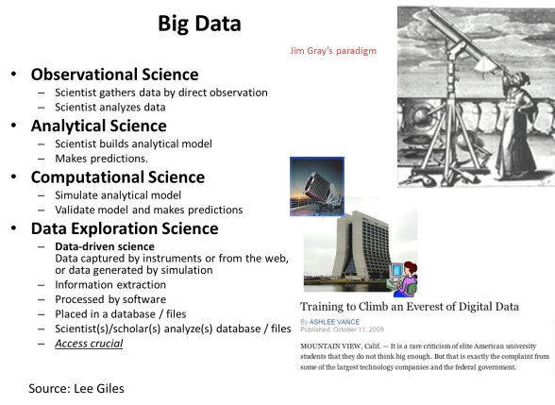
Here’s the problem
“Big Data” is an imprecise description of a rich and complicated set of characteristics, practices, techniques, ethics, and outcomes all associated with data. (AAPOR)
No canonical definition
By characteristics: Volume Velocity Variety (and Variability and Veracity)
By source: found vs. made
By use: professionals vs. citizen science
By reach: datafication
By paradigm: Fourth paradigm

Slide 6
Define a research question
Write down a conceptual framework/hypothesis
Check the literature
Develop an empirical approach
Why?
http://www.tylervigen.com/spurious-correlations

Slide 7
Example: LEHD
What is the return to training?
What is the impact of firms on workers (low wage work)?
What is the impact of workers on firms (productivity and competitiveness)?

Slide 8
Outline
Define a research question
Think about what data are available and the measurement error
Link datasets
Address Privacy and Confidentiality/Ethics
Disseminate results

Slide 9
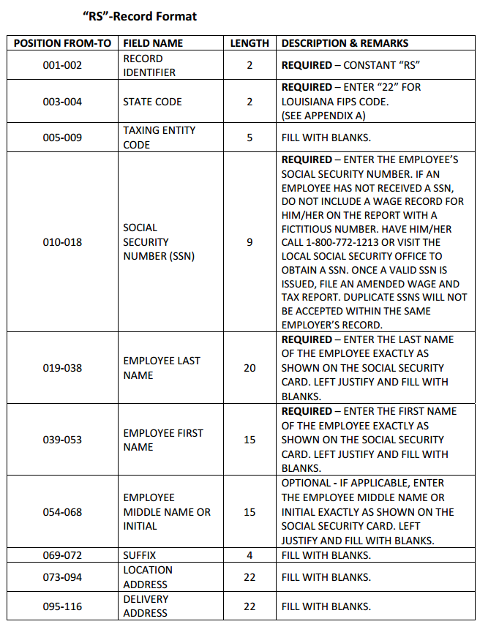
UI Wage Record data
Universal 98% of employment in partner states
Longitudinal in businesses and workers
Current Sent quarterly (six months after transaction date) – start date 1990(+)
Comparable Same definitions across states

Slide 10
Measurement Error
Data generation process (Kreuter and Peng, 2014)
Total error = Row error + Column error + Cell error (Thanks to Paul Biemer, 2015)

Slide 11
Row error
Omissions – some rows are missing which implies that elements in the target population are not represented on the file
Duplications – some population elements occupy more than one row
Erroneous inclusions – some rows contain elements or entities that are not part of the target population

Slide 12
Column error
Specification error
  Concept (what is the underlying latent variable of interest)
  Measurement (what is the actual measurement used)
  Interpretation (how is the analyst interpreting it)

Slide 13
Cell error
content error (problems in the measurement process, transcription error, data processing error)
specification error (error in data capture for specific units)
missing data (the measurement process, transcription error, data processing error

Slide 14
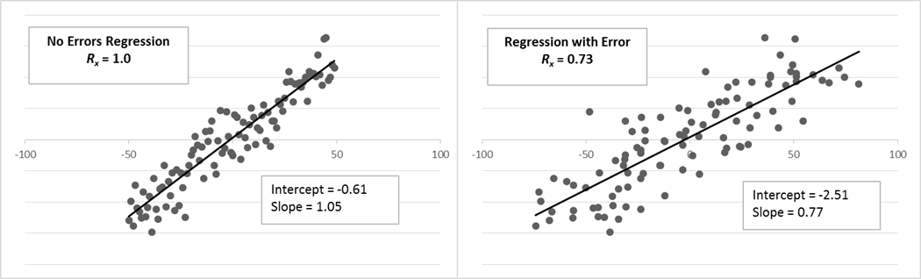
Consequences for inference
Regression on y on x with and without Variable Error. The figure on the left is the population regression with no error in the x variable. On the right, variable error was added to the x-values with a reliability ratio of 0.73. Note its attenuated slope which is very near the theoretical value of 0.77 (Source, Paul Biemer, 2015)

Slide 15
Mitigation
Major challenge with big data (and not corrected with large samples!)
  data editing and cleaning
  Anomaly identification and resolution (Chandola et al, 2009)
  selective editing strategies (see for example, Granquist and Kovar, 1997; De Waal, Pannekoek, and Scholtus, 2011)

Slide 16
Mitigation
data mining (Natarajan, Li, and Koronis 2009),
machine learning (Clarke, 2014)
cluster analysis (Duan, Xu, and Lee, 2009; He, Xu, Deng, 2003)
various data visualization tools such as treemaps (Shneiderman, 1992; Tennekes, de Jonge and Daas, 2012)
tableplots (Tennekes, de Jonge and Daas 2013; Tennekes, 2012; Puts, Daas and de Waal, 2015)

Slide 17
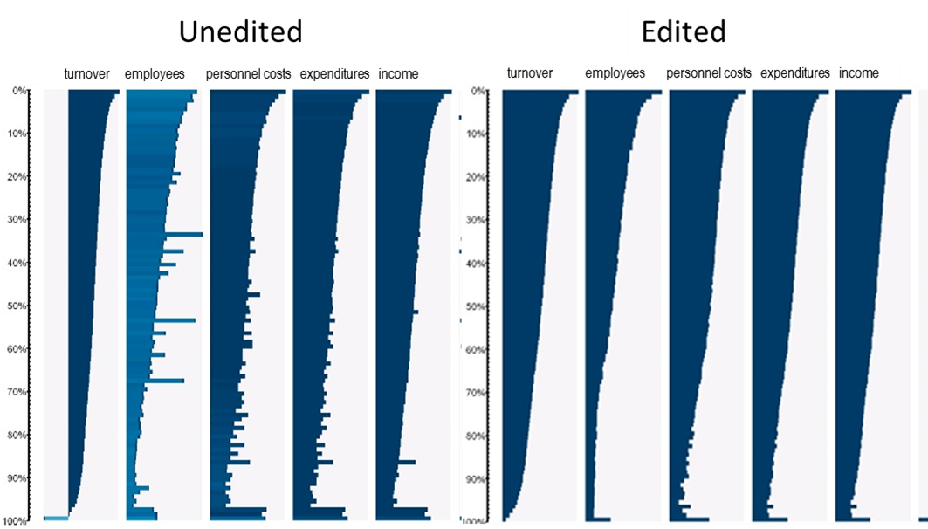

Slide 18
Outline
Define a research question
Think about what data are available and the measurement error
Link datasets
Address Privacy and Confidentiality/Ethics
Disseminate results

Slide 19
UI Wage Record data
Universal 98% of employment in partner states
Longitudinal in businesses and workers
Worker Information Date of birth, place of birth, sex, earnings
Firm Information Four digit industry, turnover, growth, sales
Current Sent quarterly (six months after transaction date) – start date 1990(+)
Comparable Same definitions across states
Detailed Geography: place of residence and place of work to latitude/longitude

Slide 20
LEHD data
Demographic Surveys
Link Record
Person-ID Employer-ID
Data
Economic Censuses and Surveys
Census Entity-ID Data
Household Record
Household-ID
Data
Person Record
Household-ID
Person-ID
Data
Business Register
Employer-ID
Census Entity-ID
Data

Slide 21
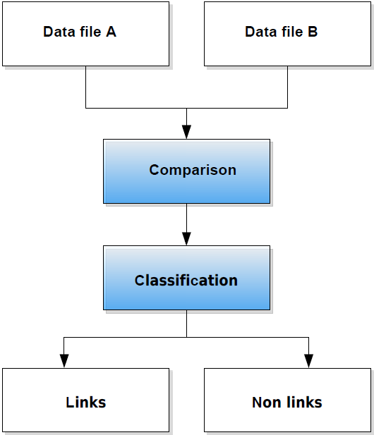

Slide 22
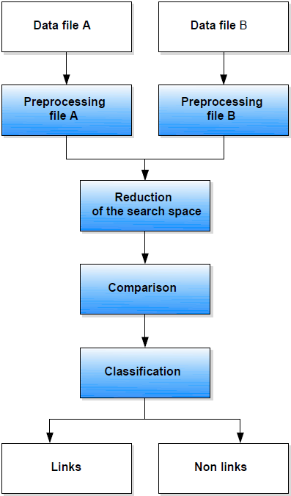

Slide 23
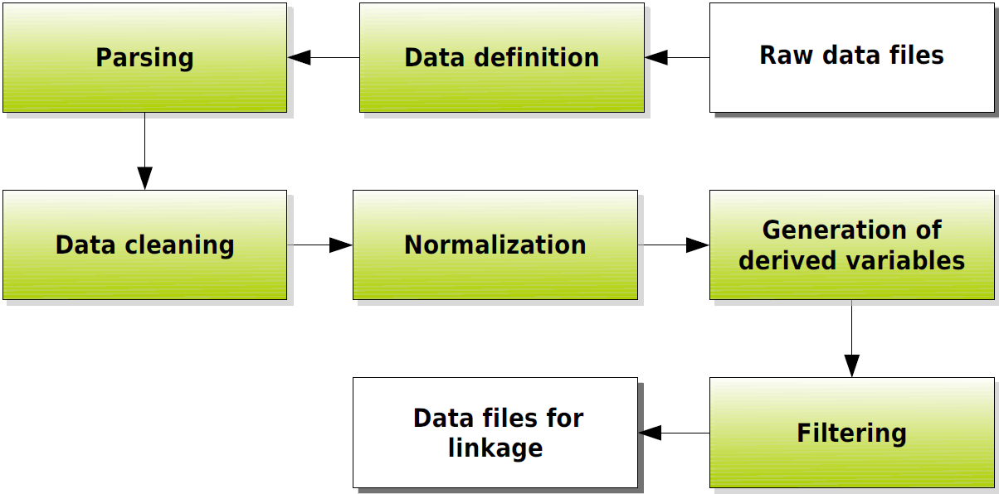
Preprocessing: Workflow

Slide 24
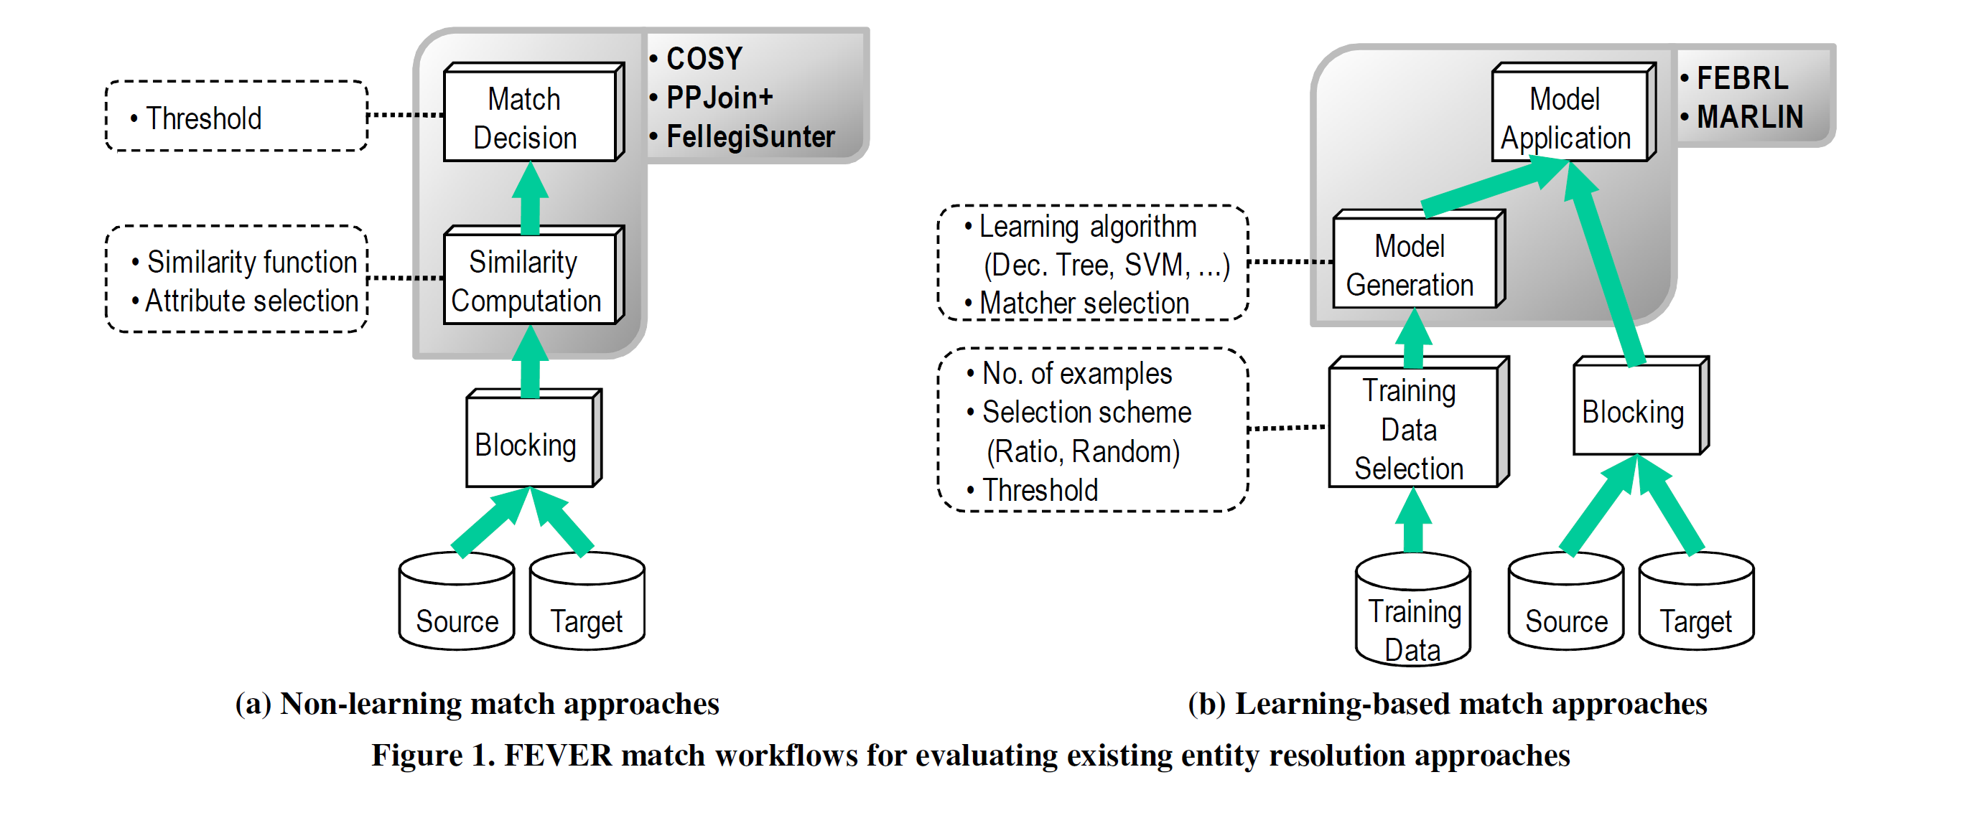
Source: Köpcke H, Thor A, Rahm E. Evaluation of entity resolution approaches on real-world match problems. Proceedings of the VLDB Endowment. 2010.

Slide 25
 | UMASS |  | ISTIC |  | FLEMING/LI
 | Results when trained on random mixture dataset | Results when trained on common characteristics dataset | Results when trained on random mixture dataset | Results when trained on common characteristics dataset | No training
Precision | 0.999709 | 0.999719 | 0.998488 | 0.991932 | 0.999941418
Splitting | 0.033936 | 0.033358 | 0.116845 | 0.103866 | 0.184882461
Recall | 0.966064 | 0.966642 | 0.883155 | 0.896134 | 0.815117539
Lumping | 0.000281 | 0.000271 | 0.001337 | 0.007289 | 4.78E-05
F score | 0.982599 | 0.982903 | 0.937287 | 0.941603 | 0.898119352
True Positives | 384367 | 384597 | 351380 | 356544 | 324310
False Negatives | 13502 | 13272 | 46489 | 41325 | 73559
False Positives | 112 | 108 | 532 | 2900 | 19
Runtime | 7 hours on c3.8xlarge AWS instance |  | 7 hours on c3.8xlarge AWS instance |  | N/A
 | (CPU usage topped at 69%) |  | (CPU usage topped at 11.85%)
Source: PatentsView Evaluation

Slide 26
Outline
Define a research question
Think about what data are available and the measurement error
Link datasets
Address Privacy and Confidentiality/Ethics
Disseminate results

Slide 27



Slide 28
Impossible to ask for consent

Slide 29
Approach
Change way in which we access and disseminate data

Slide 30
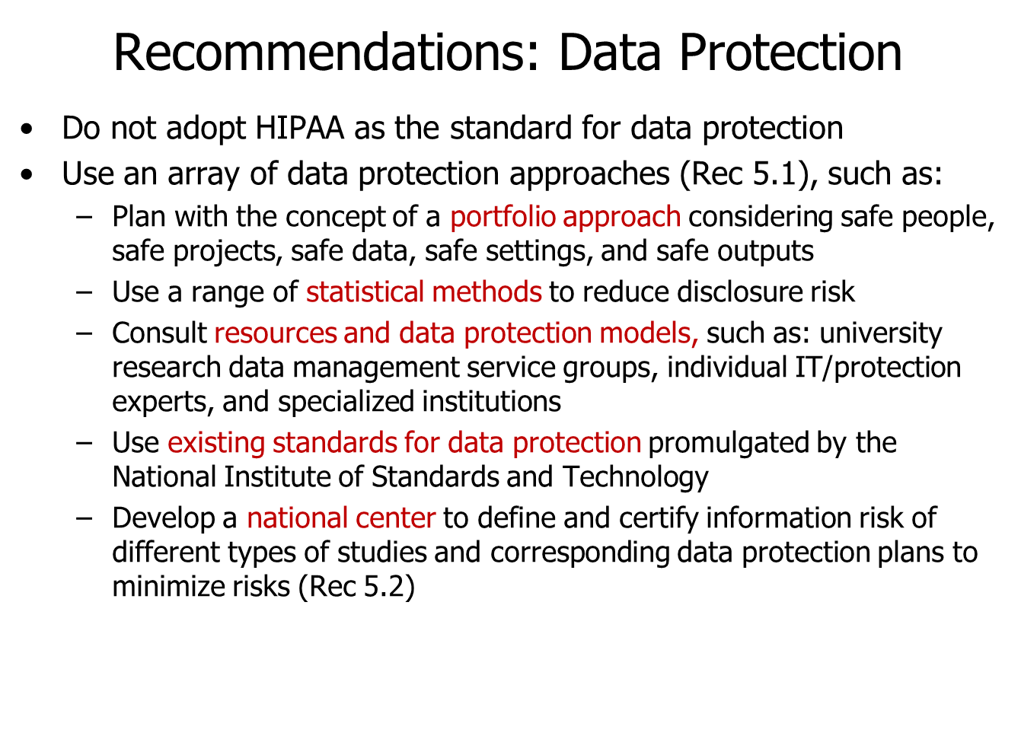

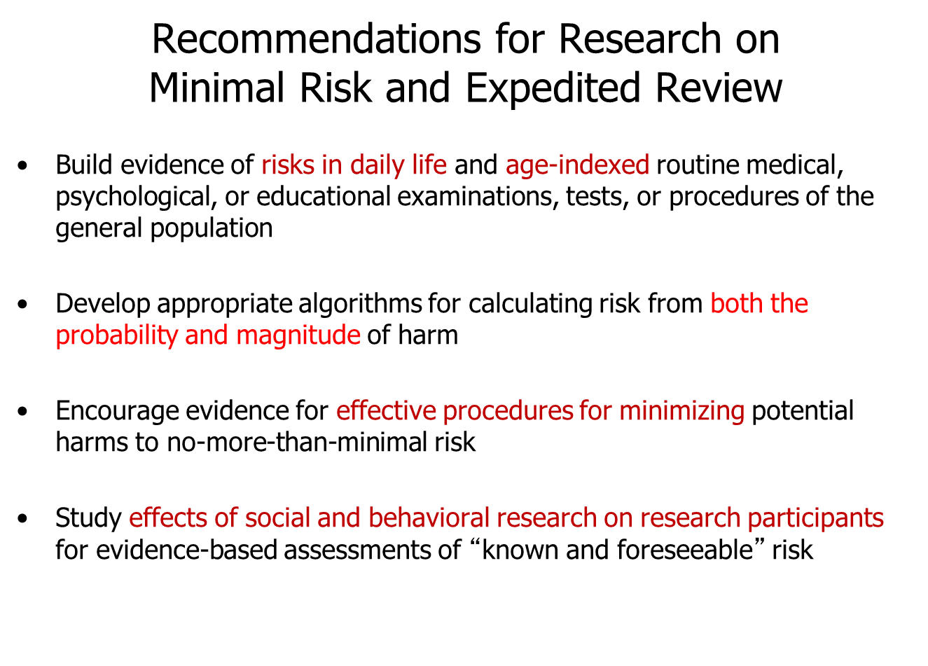
Common Rule Suggestions
Source: Julia Lane

Slide 31



Set up major research facilities

Slide 32
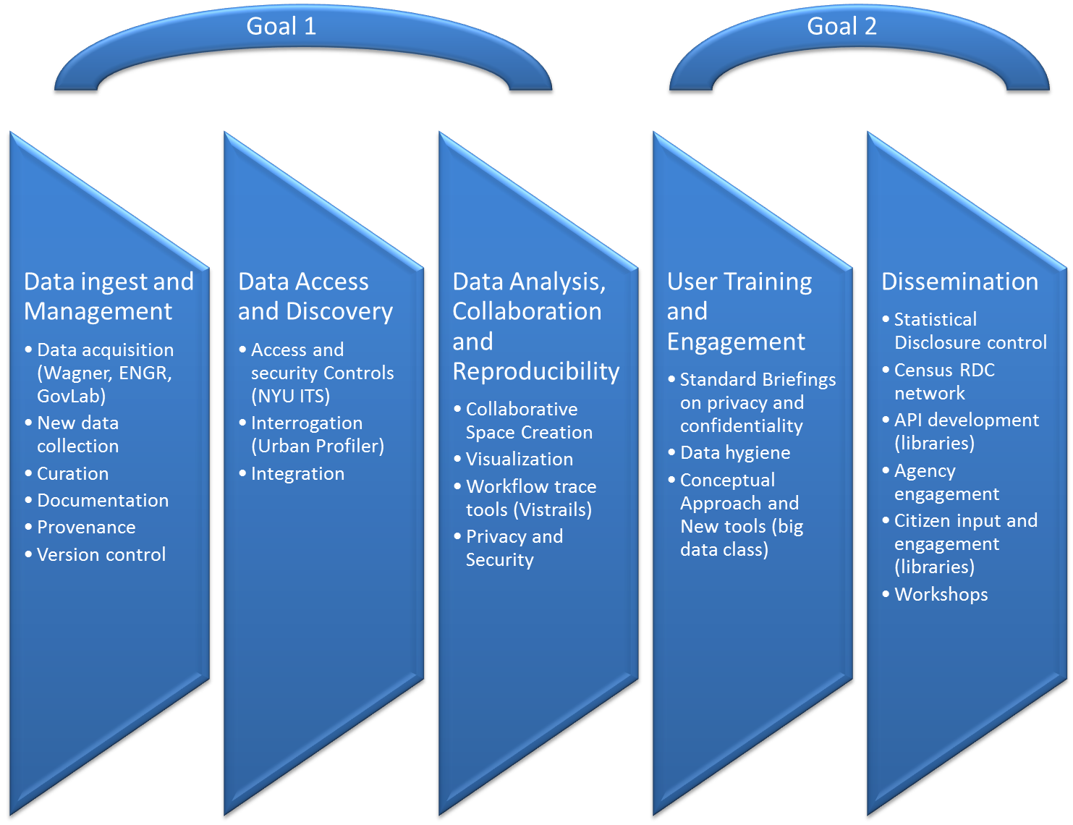
Practical approach

Slide 33
Outline
Define a research question
Think about what data are available and the measurement error
Link datasets
Address Privacy and Confidentiality/Ethics
Disseminate results

Slide 34
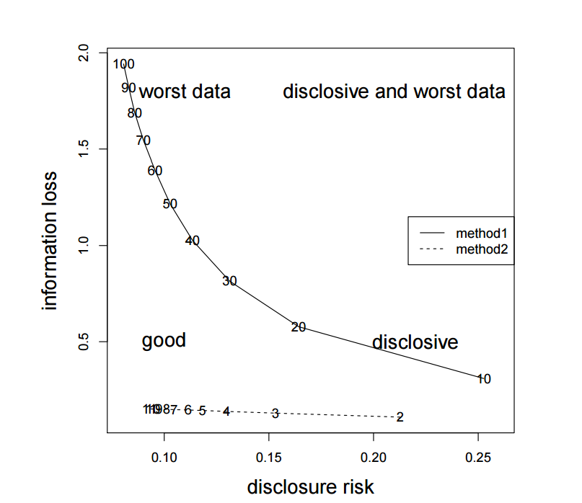
Core challenge
Introduction to Statistical Disclosure Control (SDC) Matthias Templ, Bernhard Meindl and Alexander Kowarik http://www.data-analysis.at

Slide 35
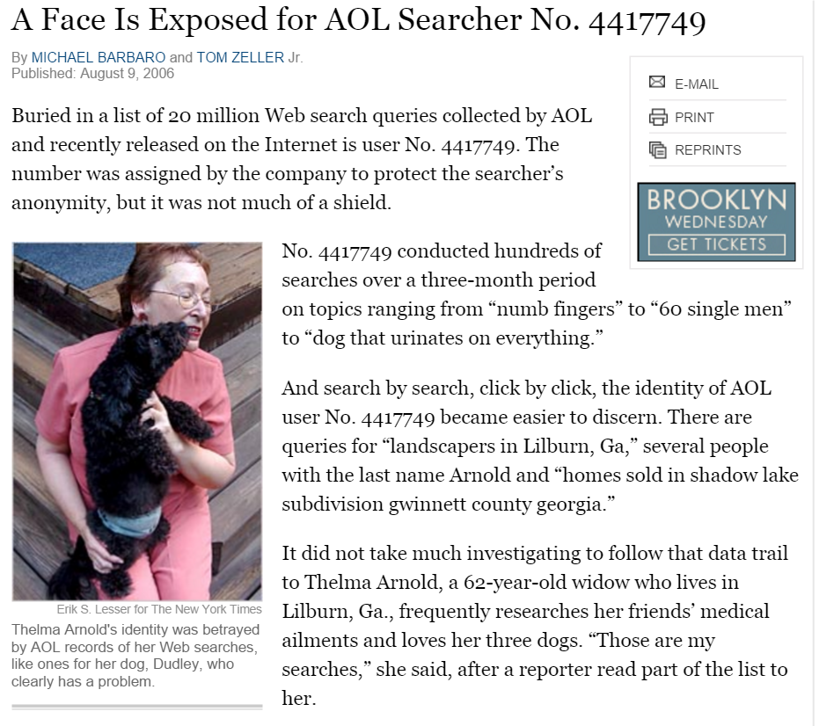
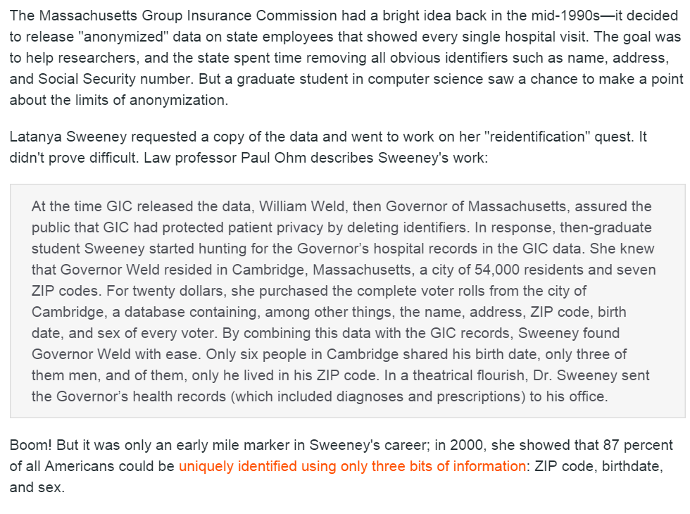
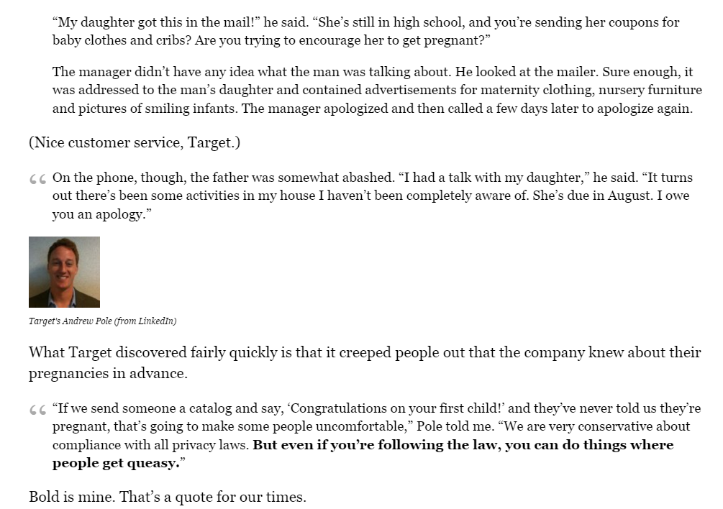
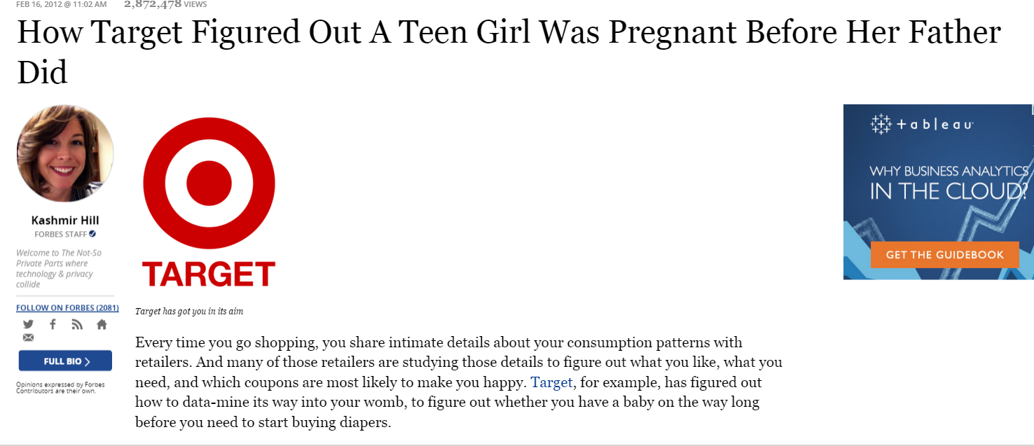
What is disclosure
Identity disclosure
  linkage with external available data
Attribute disclosure
Inferential disclosure

Slide 36
Approaches
basic risk measurement
Recoding
local suppression
PRAM (postrandomization)
information loss measures
Shuffling
Microaggregation
adding noise

Slide 37
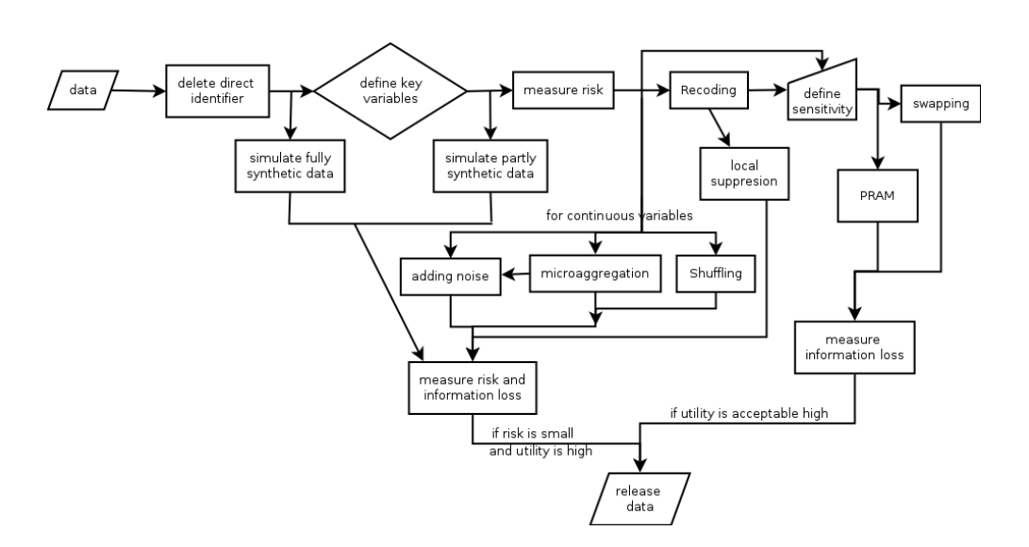
Example
Introduction to Statistical Disclosure Control (SDC) Matthias Templ, Bernhard Meindl and Alexander Kowarik http://www.data-analysis.at

Slide 38
Practical approach

Slide 39
And a reminder of why
Measures measures everywhere – we have to stop and think
what are we measuring?
how are we measuring it?
what are we missing?
are we protecting human subjects?
can people be reidentified?

